Slide 1



Multi-Channel RF power detector
TEAM Mosfet
Gunasekara L.U.A – 230212H Peiris T.S.R – 230470U Elapatha C.D – 230171E Kariyawasam J.H.D – 230318M

Slide 2
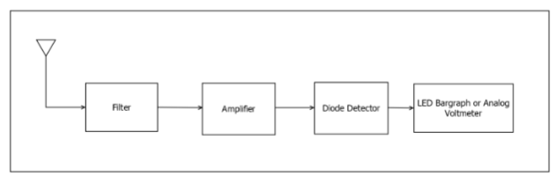
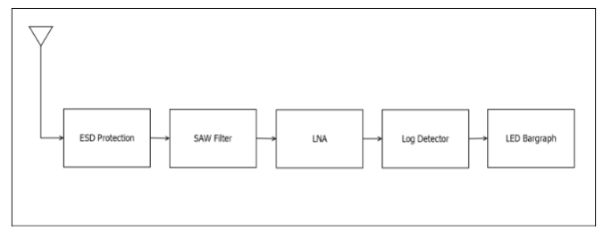
Initial block diagram
Block diagram of current design after feedback

Slide 3
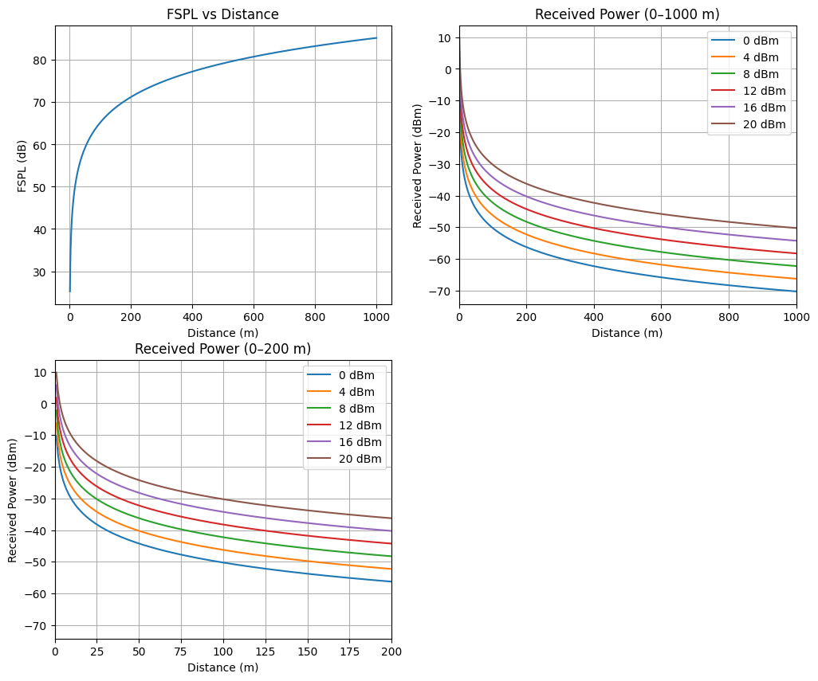
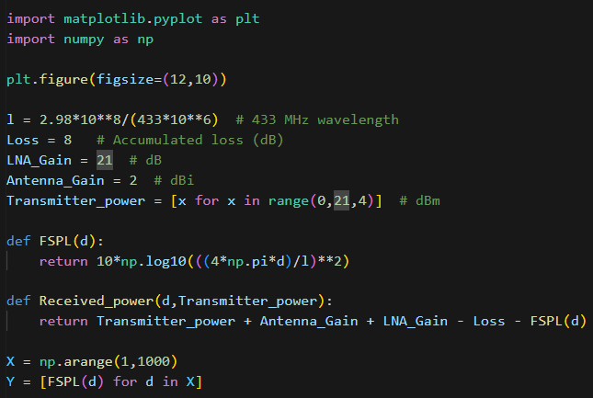
Prior to reaching the circuit architecture
Practical realization of losses and factoring in noises

Slide 4
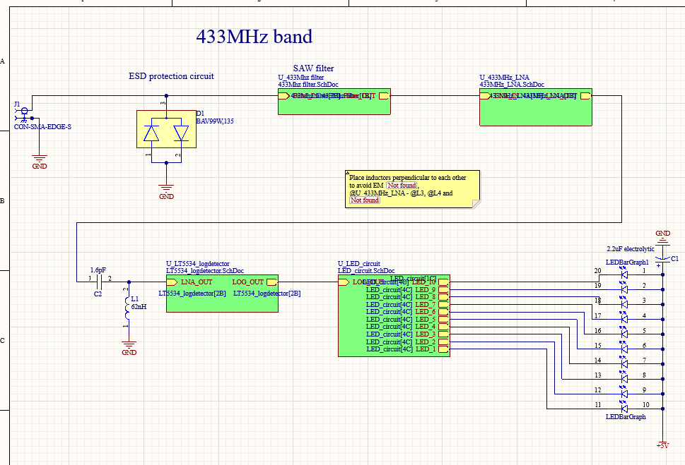
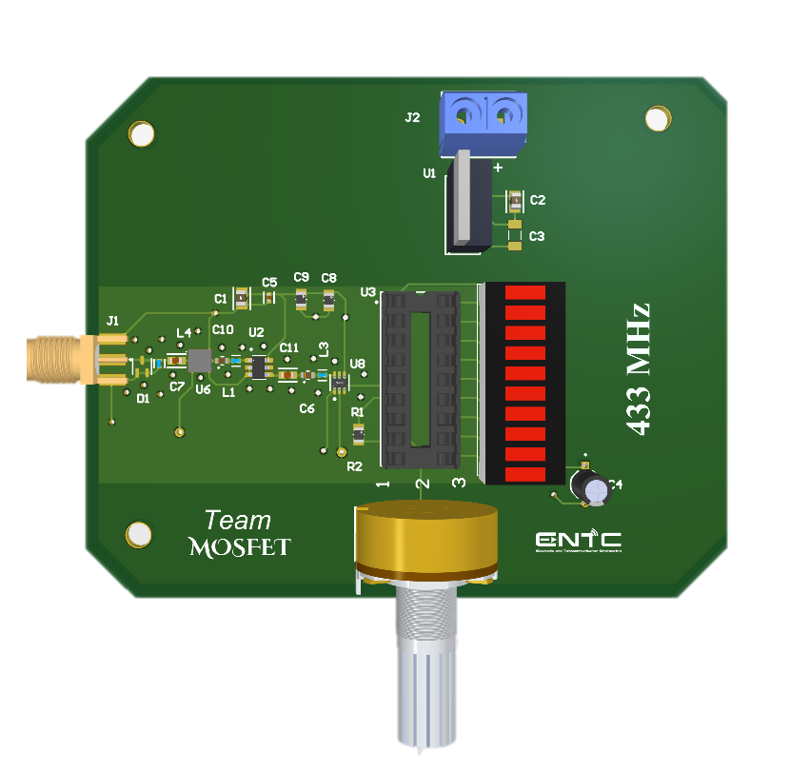
SAW filter
Log detector
Power Supply
LNA
ESD Protection
LED Circuit

Slide 5
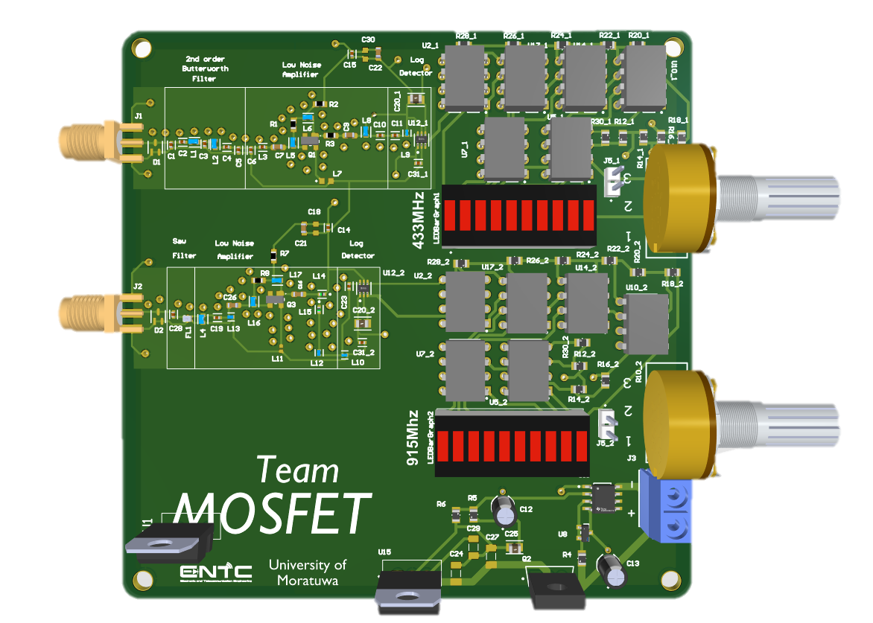
First design for 433MHz band
Final design for 433MHz & 915 MHz bands
SAW filter
Log detector
Power Supply
LNA
ESD Protection
LED Circuit

Slide 8
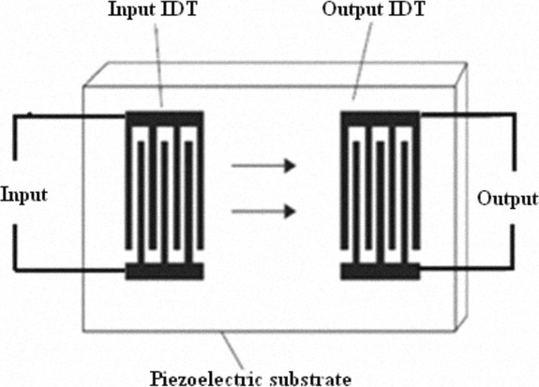
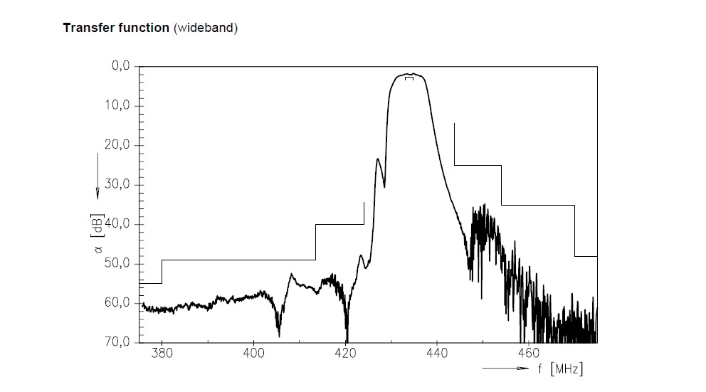
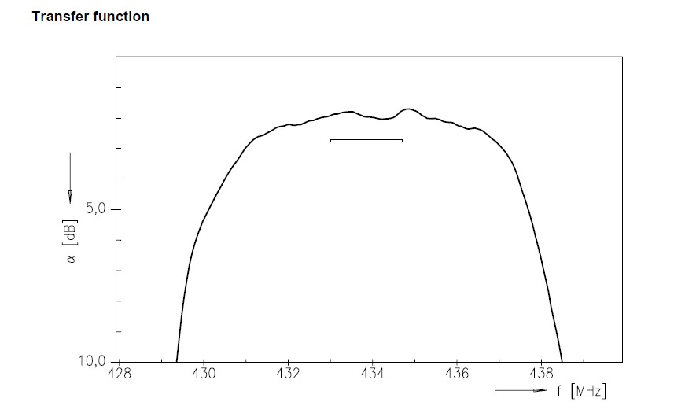
SAW filter
SAW filter internal structure
Transfer function wideband
Transfer function narrowband

Slide 9
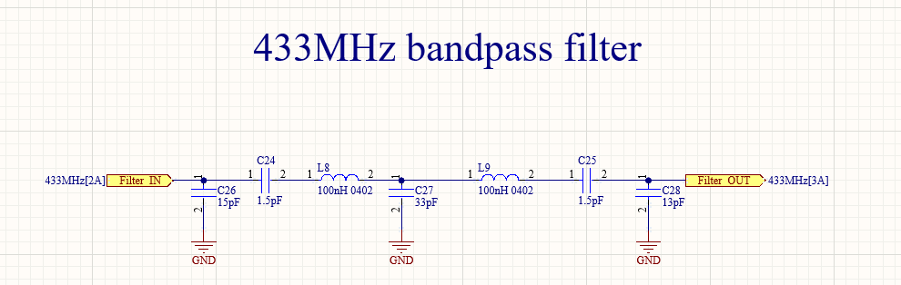
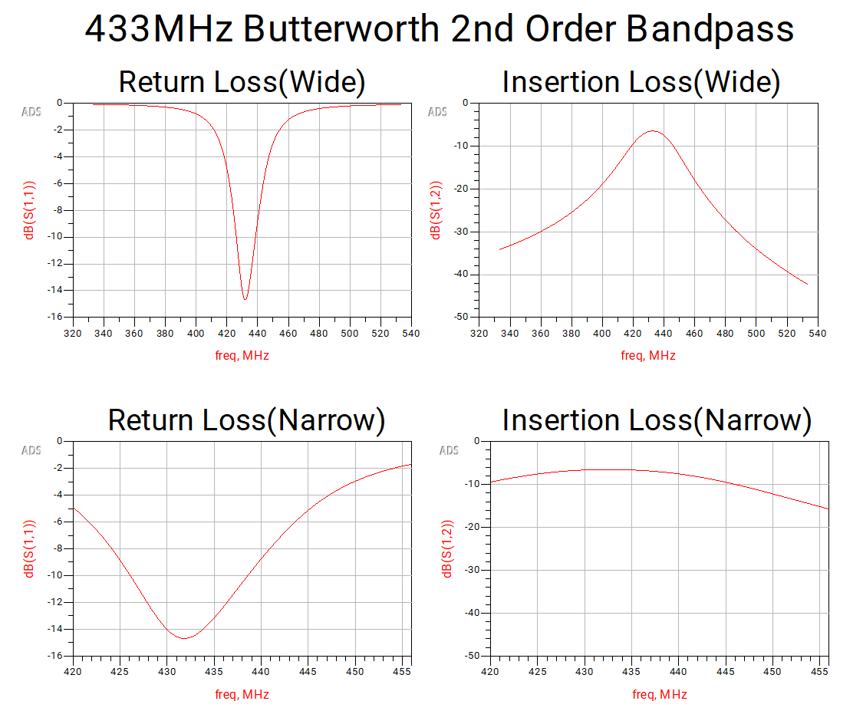
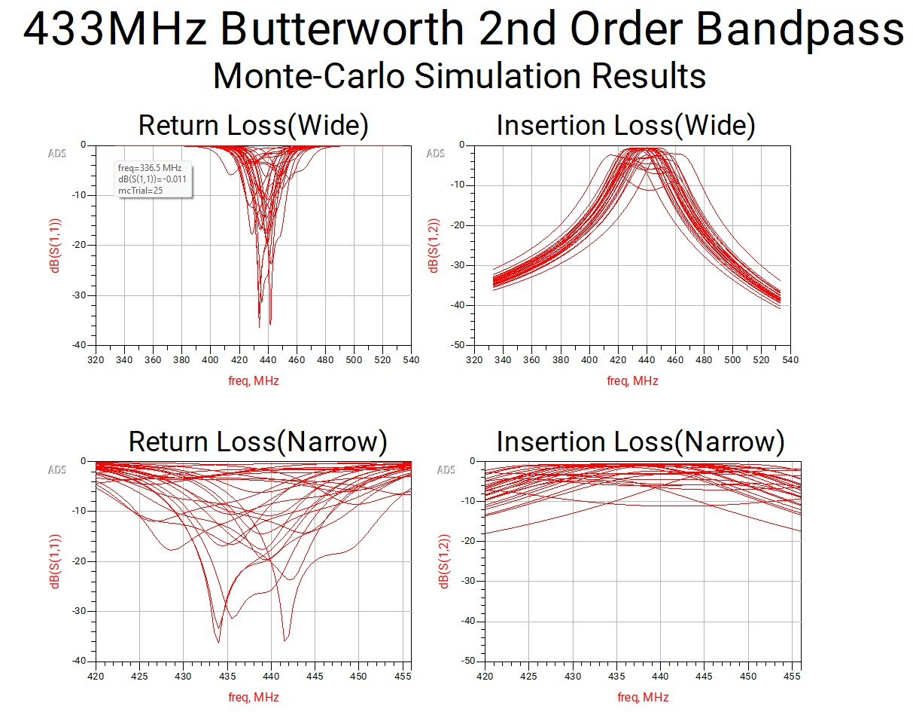
Designed filter

Slide 10
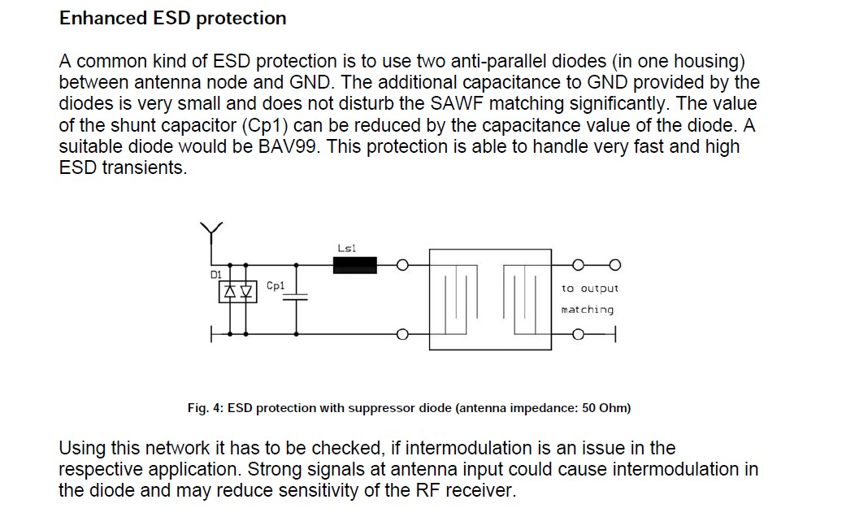
Application NoteSAW-ComponentsESD protection for SAW filters - Qualcomm

Slide 11
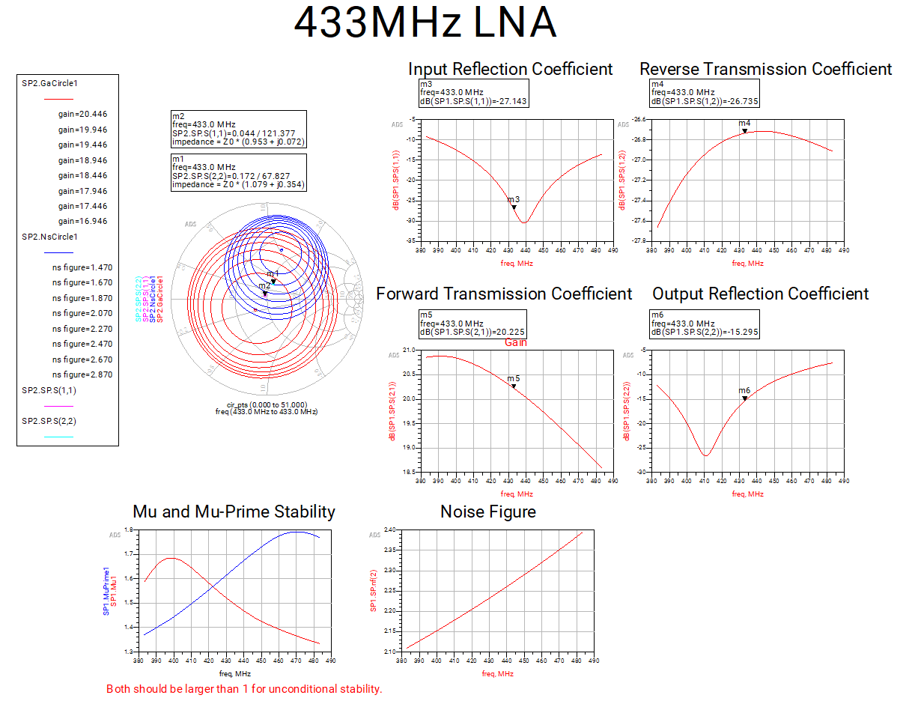
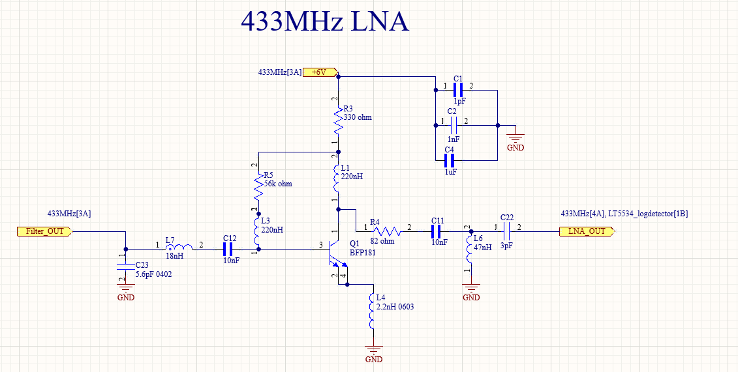

Slide 12
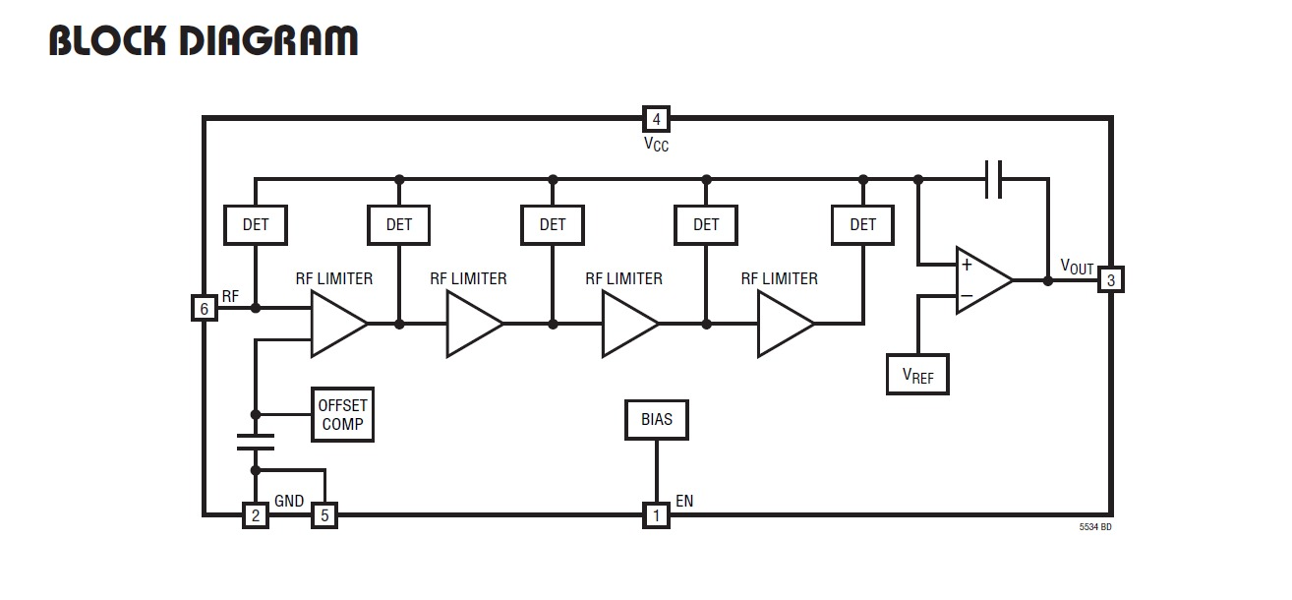
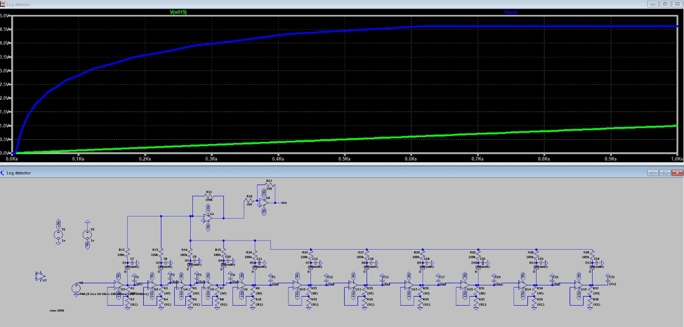
LT5534 – log detector IC
Successive log detector amplifier IC simulation
with universal operational amplifiers

Slide 13
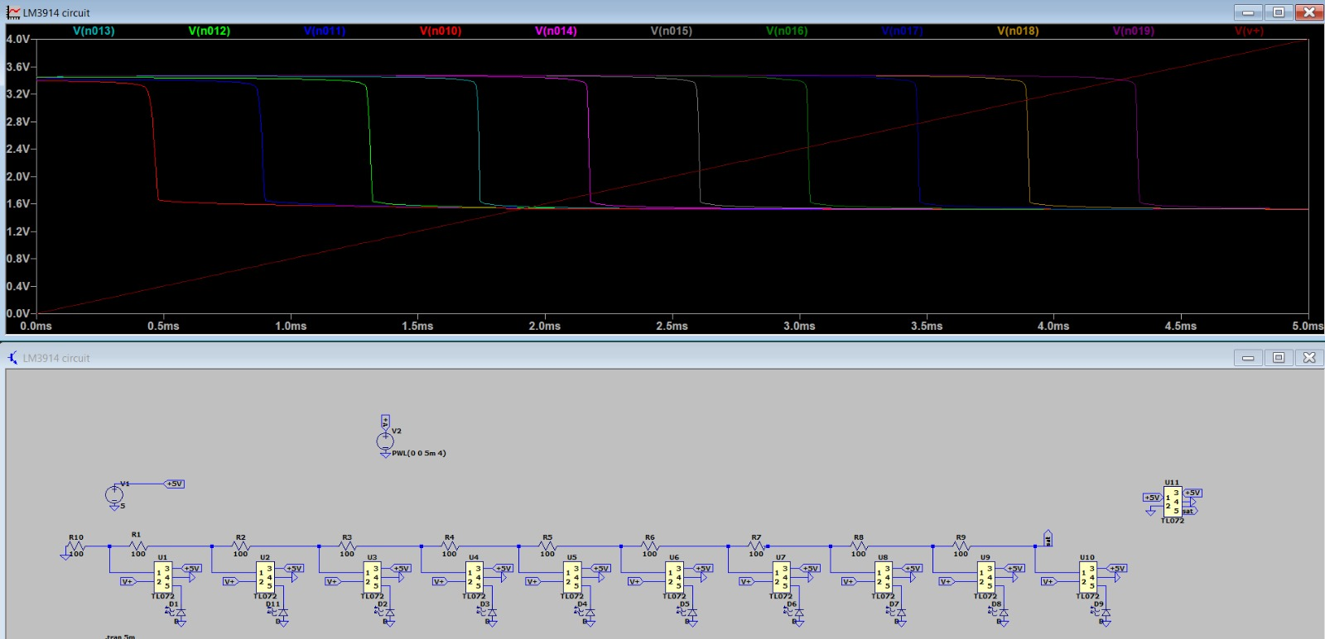
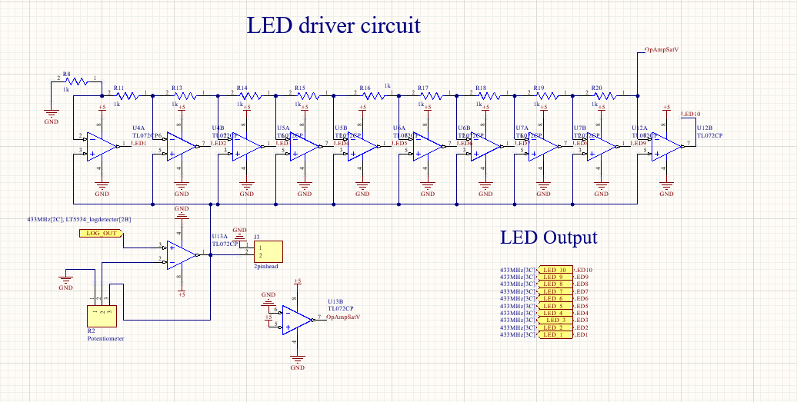
LED driver – LM3914 used in previous design
LED driver – Current circuit designed following LM3914 datasheet
LED driver simulation

Slide 14
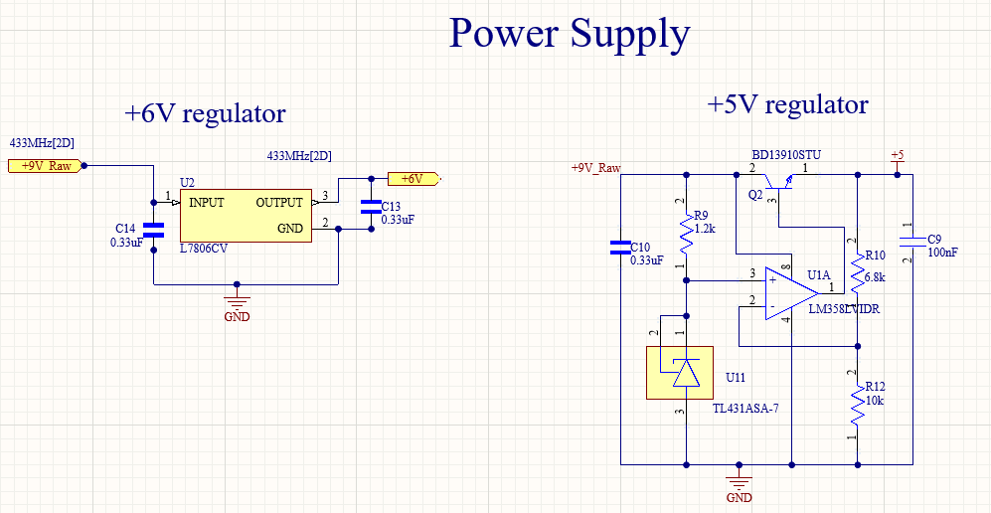
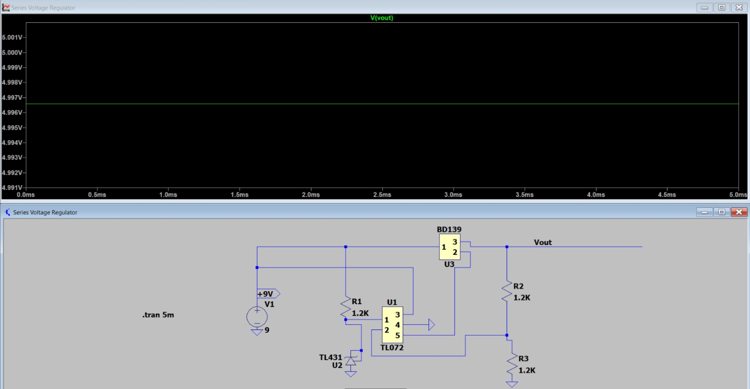
Power Supply and regulation
Simulated 5V power regulator
Power Supply circuit
Feedback based series regulator for 5V
7806 regulator for fixed 6V supply

Slide 15
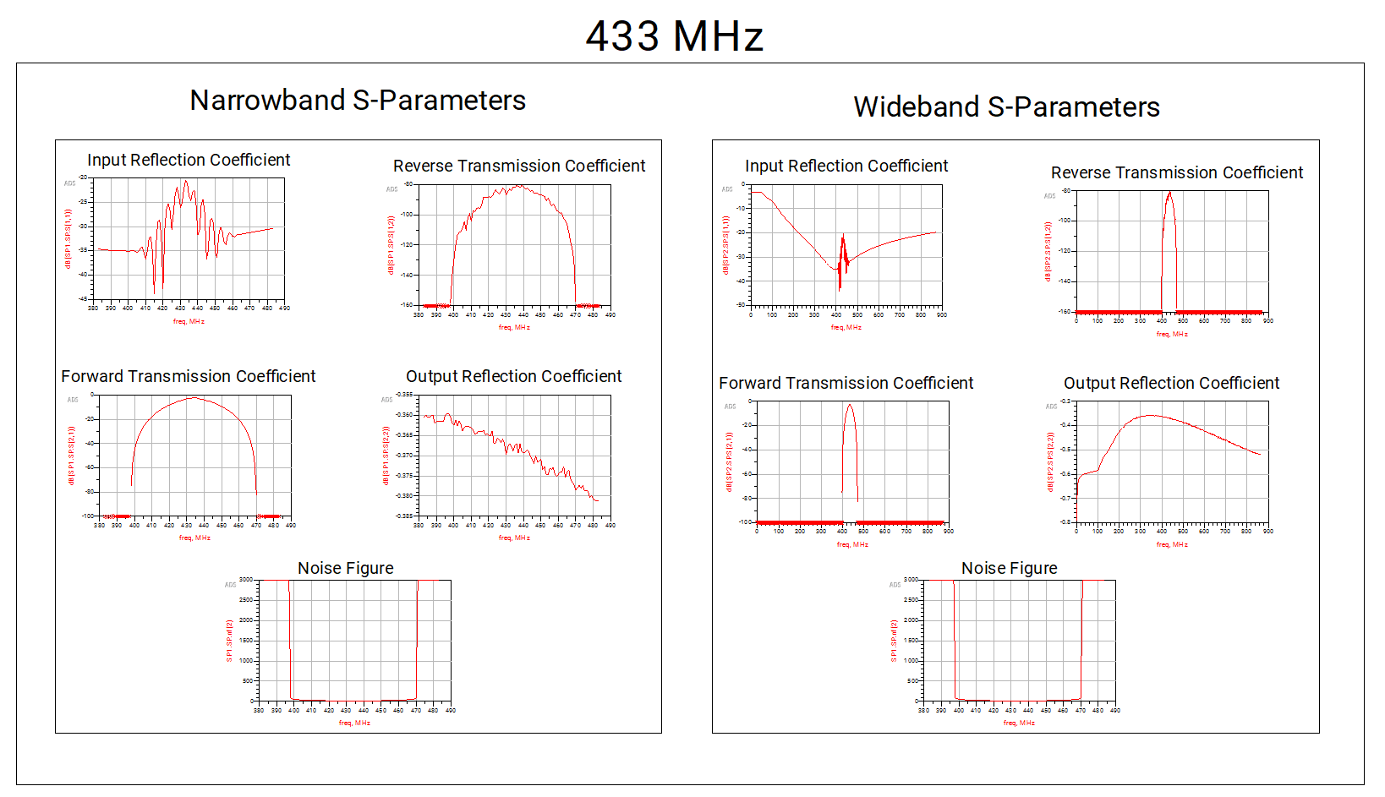
Overall frequency response of previous design for 433Mhz

Slide 16
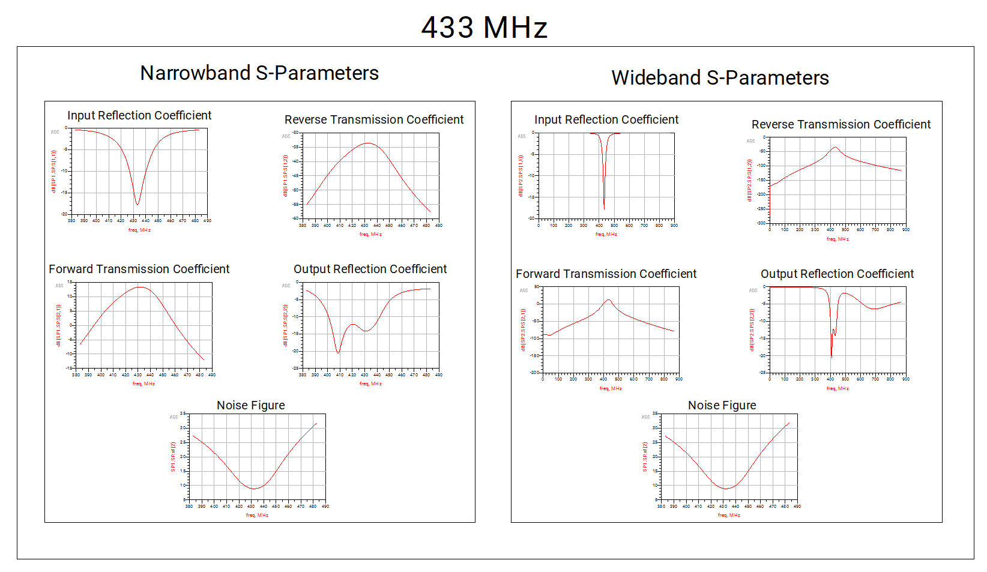
Overall frequency response of current design for 433Mhz

Slide 17
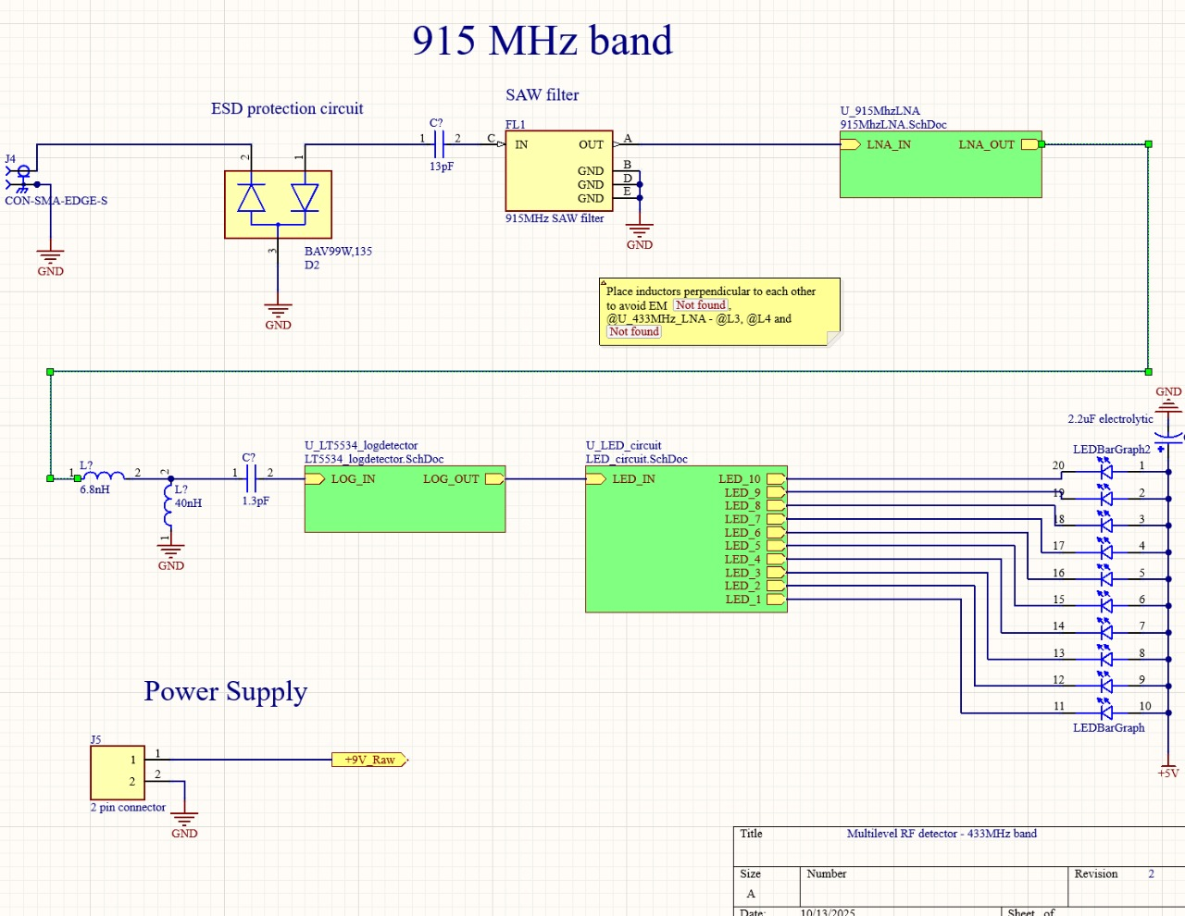

Slide 18
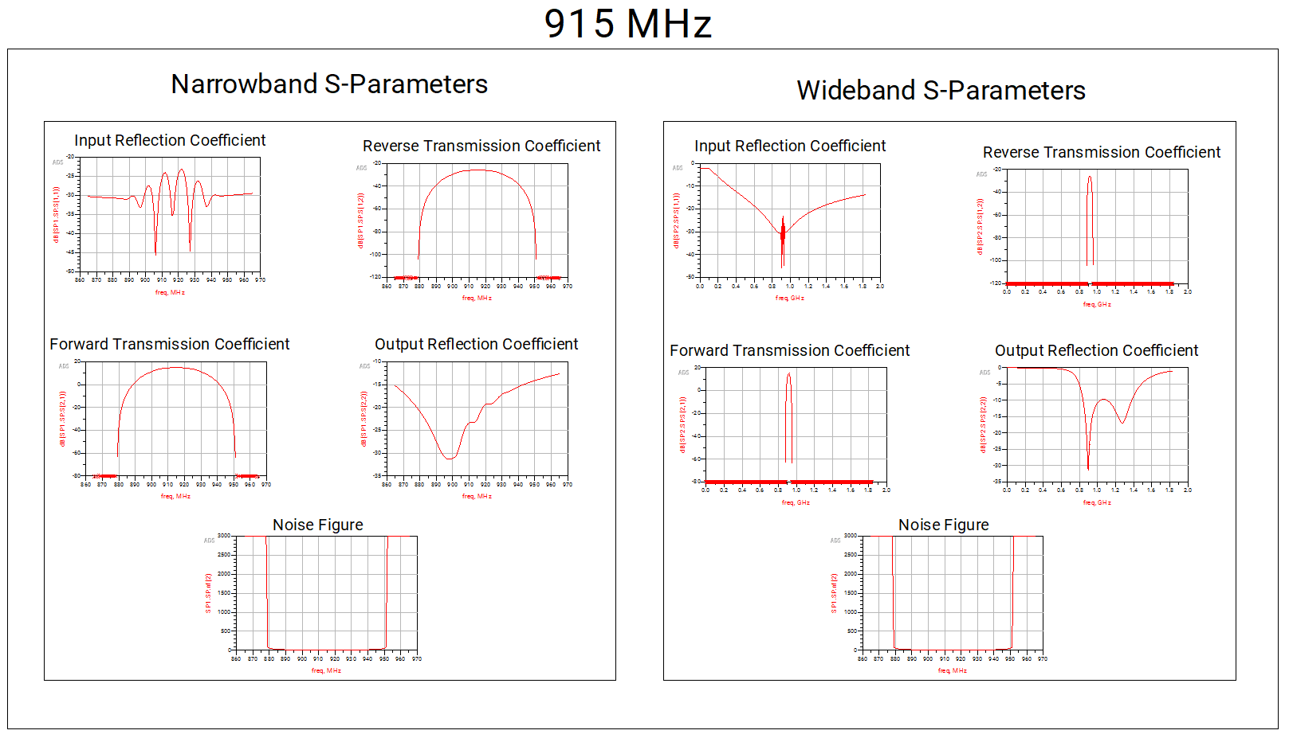
Overall frequency response of current design for 915Mhz band

Slide 19
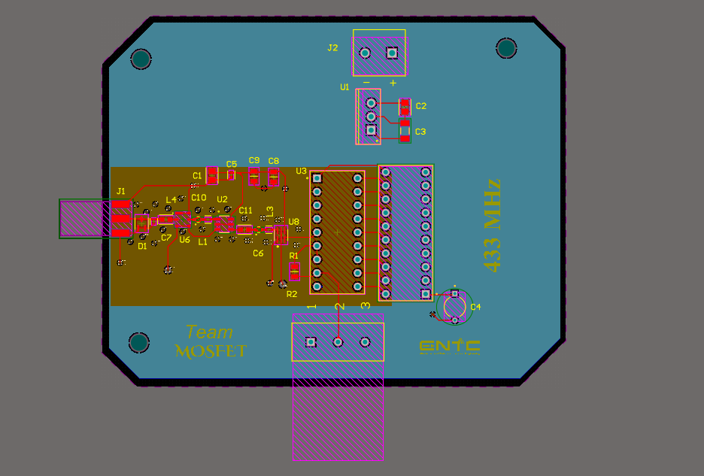
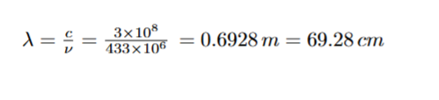
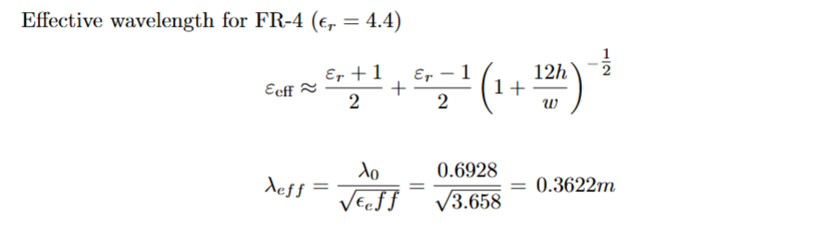
PCB layout and design
Design rules followed
Inserting a ground plane to provide a return path for RF.
Placing vias as RF fencing for the RF trace and teardrops for impedance matching.
Closely placed inductors were places perpendicular to minimize EMI.
Guided wavelength calculation was done for frequency corresponding to dielectric material used (FR-4)
4 layer PCB stack-up

Slide 20
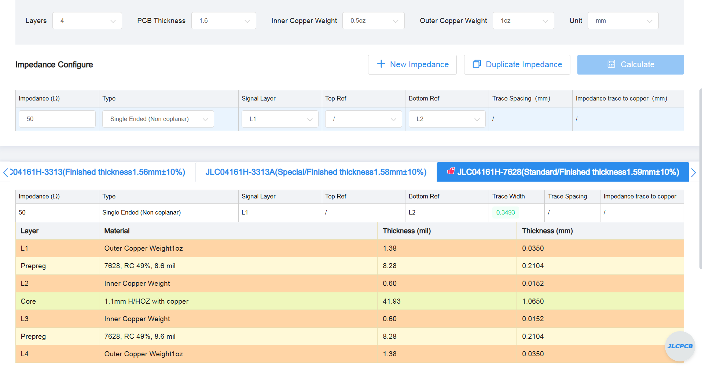
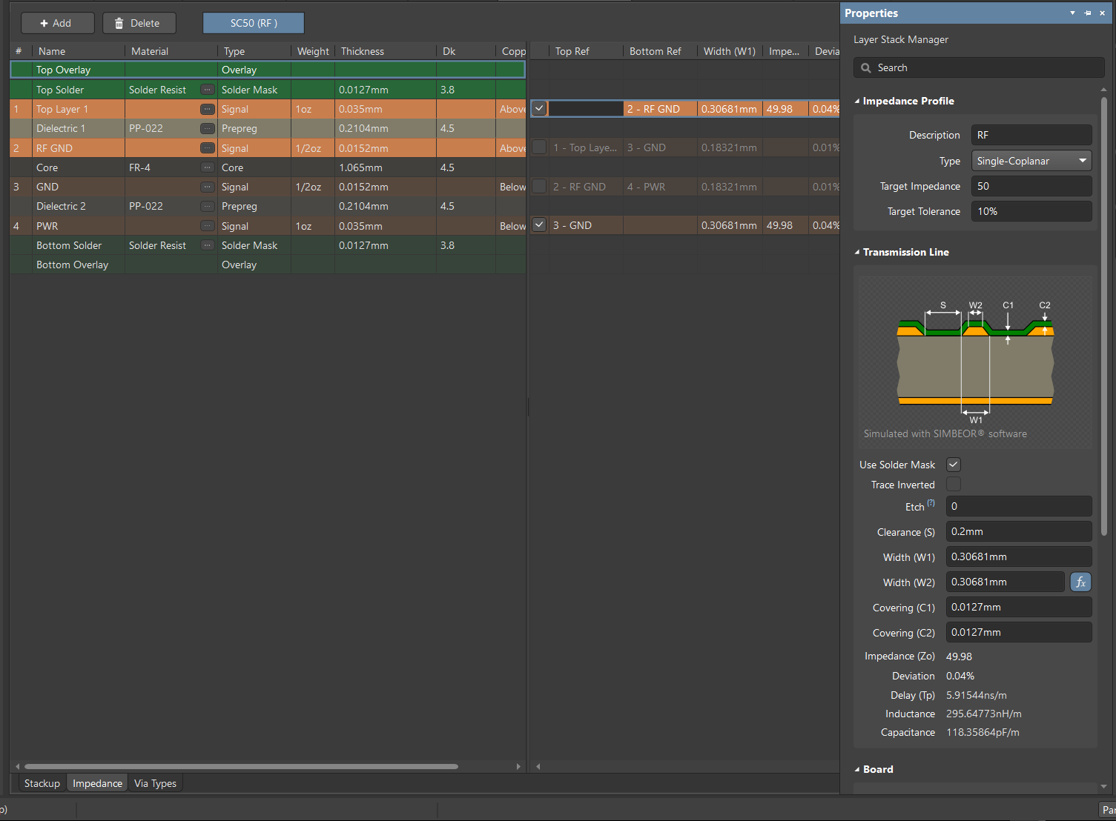
PCB design for RF constraints
JLC impedance matched 4 layer stack-up JLC0416H - 7628
Impedance matched to 50Ὼ
Trace width calculated from JLC and Altium were slightly different (0.04mm) , JLC one was selected.

